Slide 1

Big Data Analytics in Sustainable Fisheries: Tanzania's GDP Impact (2014-2016)
A Capstone Project in Data Science

Slide 2

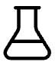


Project Overview
Navigating the Waters of Economic Impact
Introduction
Methodology
Understanding the intricate relationship between sustainable fisheries and national economic growth in Tanzania.
A detailed look into our approach, from data acquisition to model evaluation.
Key Findings
Recommendations & Future Work
Presenting the analytical results and their implications for policy.
Proposing actionable insights and pathways for continued research.

Slide 3
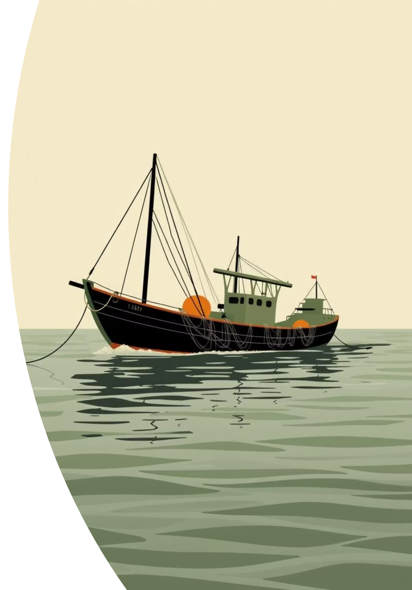
Project Introduction
Assessing the Economic Contributions of Sustainable Fisheries in Tanzania
This project investigates how big data analytics can quantify the impact of sustainable fisheries on Tanzania’s Gross Domestic Product (GDP) between 2014 and 2016. Understanding this nexus is crucial for informed policy-making and sustainable resource management.

Slide 4
Methodology
From Raw Data to Actionable Insights
Our methodology follows a rigorous process to ensure data integrity and robust analytical outcomes.

Slide 5
Methodology: Data Acquisition & Preprocessing
Casting a Wide Net for Relevant Data
Dataset Identification
Data Cleaning & Transformation (Python)
Dataset Title: Tanzania Fisheries & Economic Indicators
Missing Values: Imputation using K-Nearest Neighbors (KNN) for numerical features; mode imputation for categorical data.
Source Link: Link to Data Source
Rows & Columns: Approx. 3,500 rows, 15 columns (e.g., Fish Catch Volume, Export Value, GDP by Sector, Fishery Employment, Sustainability Indices)
Outliers: Detection via Z-score and Isolation Forest; handled by Winsorization.
Structure: Predominantly Structured (CSV/Excel)
Inconsistent Formats: Standardization of date formats and categorical entries.
Status: Requires Preprocessing (Missing values, outliers, inconsistent formats)
Transformations: One-Hot Encoding for categorical variables; StandardScaler for numerical features to ensure model compatibility.

Slide 6
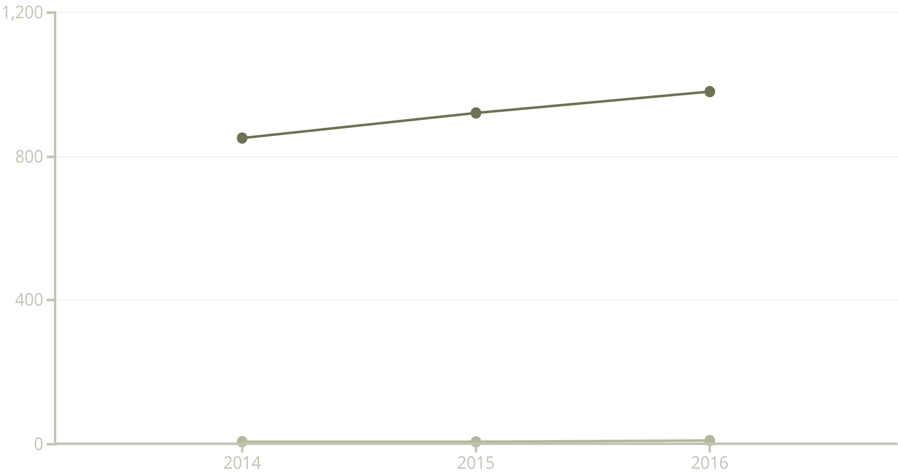
Methodology: Exploratory Data Analysis (EDA)
Unveiling Patterns in the Data Deep Dive
Fisheries GDP Contribution ...
Sustainable Fishing Index
EDA confirmed a positive correlation between sustainable fishing practices and increased GDP contribution from the fisheries sector. Distributions were visualized using histograms and box plots, while relationships were explored via scatter plots and correlation matrices.

Slide 7
Methodology: Model Application & Evaluation
Predicting Economic Impact
Machine Learning Model
Model Evaluation
Model Chosen: Ridge Regression
Metrics Used:
Reasoning: Selected for its effectiveness in handling multicollinearity and providing robust predictions for continuous target variables like GDP contribution, while incorporating a regularization term.
R-squared (R²): 0.88 (Indicates strong predictive power)
Mean Absolute Error (MAE): TZS 15 Billion (Average absolute difference between predicted and actual values)
Root Mean Squared Error (RMSE): TZS 22 Billion (Sensitive to large errors, shows model precision)
Implementation (Python):
Data split into 80% training, 20% testing sets.
Conclusion: The model demonstrates high accuracy in predicting the economic impact of sustainable fisheries, providing a reliable foundation for policy recommendations.
Cross-validation (k=5) applied during training for robustness.

Slide 8
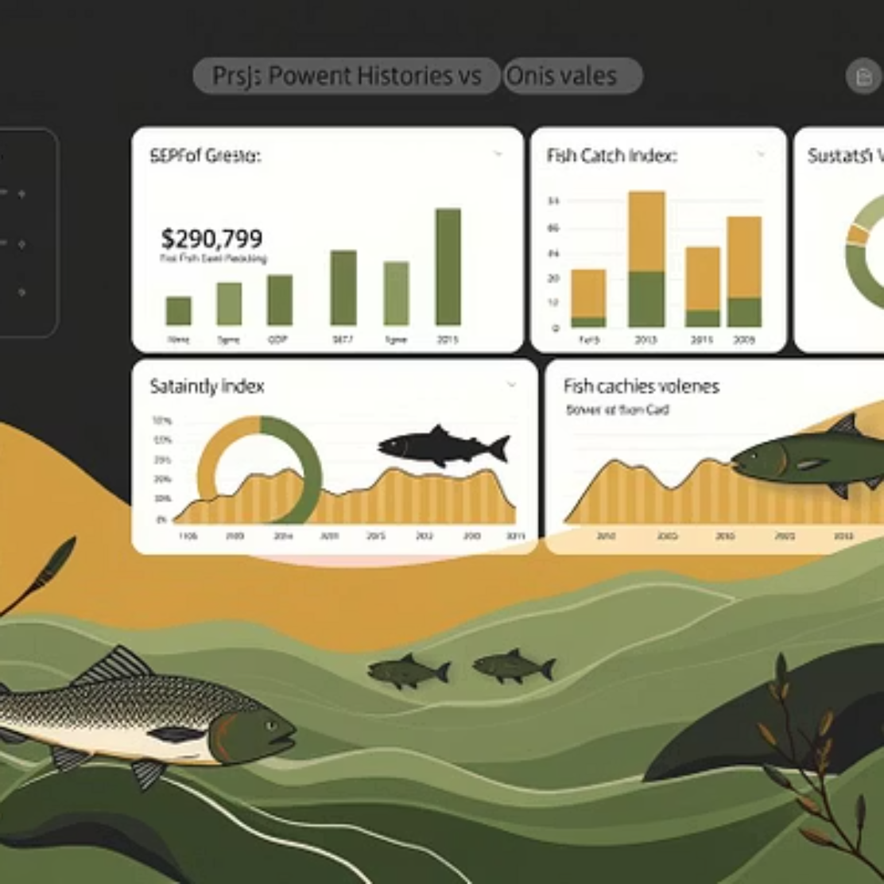
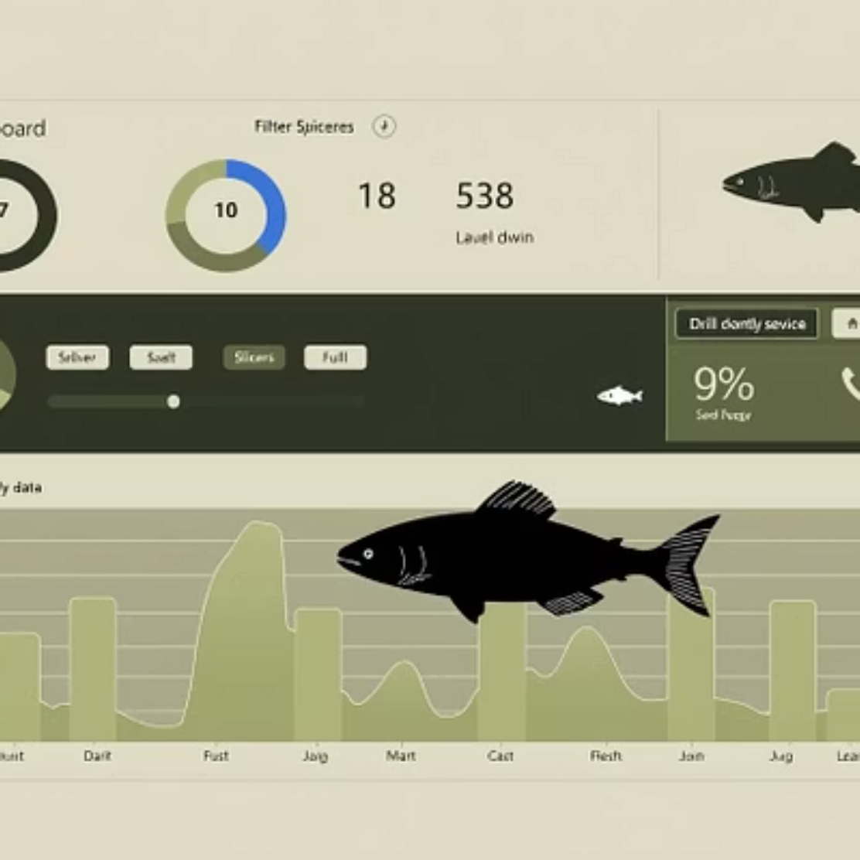
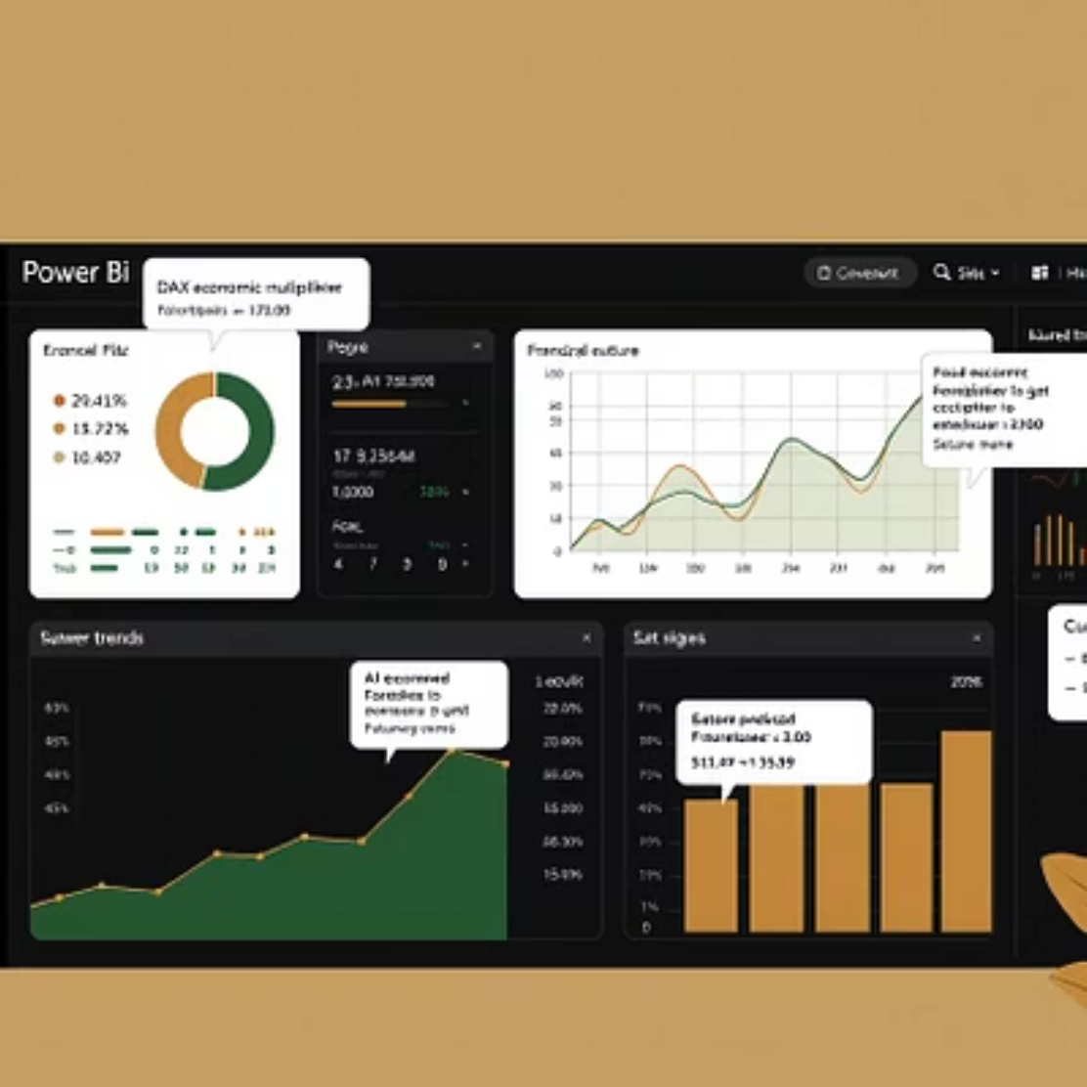
Results & Dashboard
Visualizing the Impact: Power BI Dashboard
The Power BI dashboard provides an interactive overview of our findings, translating complex data into clear, actionable insights.

Slide 9
Recommendations & Future Work
Charted Waters: Guiding Policy and Research
Key Recommendations
Future Work
Policy Support: Implement policies that incentivize sustainable fishing practices, e.g., subsidies for sustainable gear.
Expanded Data Scope: Include more recent data (beyond 2016) and additional variables like climate data, illegal fishing instances.
Data Enhancement: Invest in better data collection infrastructure for more granular insights.
Advanced Modeling: Explore time-series forecasting models (e.g., ARIMA, LSTM) for more precise future predictions.
Community Engagement: Foster collaboration with local fishing communities to ensure effective implementation of sustainable practices.
Causal Inference: Utilize techniques like Granger causality to establish stronger causal links between sustainability and economic outcomes.
Market Development: Promote value-added fish products to increase export earnings.
Geospatial Analysis: Integrate GIS data to analyze regional disparities and target interventions.

Slide 10

Thank You
For further inquiries or collaboration opportunities, please reach out.
[Your Name/Team Name] [Your Contact Information]

